Slide 1
The Relationship Between Obesity and Internet Use
BBM469 Data Intensive Applications Laboratory
Data Science Capstone Project
Gizem Kaya – Necdet Alperen Özil

Slide 2
Problem
The growth and development speed of the world is accelerating day by day. This growth benefits us in terms of technological, increasing the quality and length of human life.
For example, psychological counseling with internet connection can be very useful for an individual who is impossible to leave home.

Slide 3
Problem
However, although we think that the solution of many problems is effective, we should not forget that sometimes there may be side effects. The fact that the Internet brings distant things closer to us has made it easier for people not only in the field of health but also in many business areas. But, this not only facilitated the achievement of hard-to-achieve things, but also reduced the effort that people exerted to achieve them.
For instance, people working remotely among countries can earn money without ever leaving their homes. Or when we want to see a friend, we can see his face without going to him or her.

Slide 4
Problem
These are the privileges that come to our feet thanks to the internet, without any long or tiring effort. But we know that acting is inherent in nature, benefiting human health and prolonging life by reducing heart conditions. Obesity is one of the main diseases that have been on the agenda for the last 10 years and emerged as a result of inactivity.
We think obesity is caused by immobility, poor quality meals and eating too much food. We know that the use of the Internet completely fills our free time with the principles of social media and remote work. So much so that sometimes we don't have enough time to eat or eat. So we order fast food 'online' to meet our food needs.

Slide 5
Problem
Although these fast food foods look great, we get hungry again and want to eat again because they are of poor quality. Thus, we both eat a lot and eat high-carb meals on the effect of the internet on us. Organizing eating habits in this way may cause obesity.
In the light of these thoughts, we tried to show the connection between countries by comparing the number of citizens who are obese with internet usage by years.

Slide 6
Data Understanding
We will use 3 different datasets in this project.
The first is Internet Users,the second is Population, and the third is Obesity datasets.

Slide 7
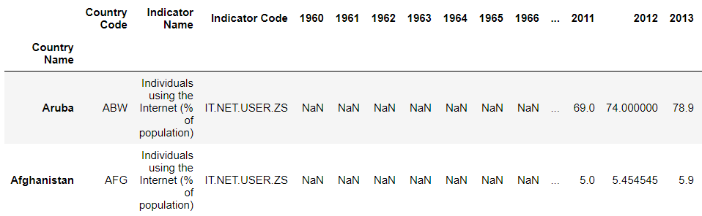
Data Understanding
Internet Users, that we found at The World Bank, includes percentage of the total number of people using the internet in 264 countries, with a separate representation for each year from 1960 to 2019. If we look at the data, we see that most of the data in the Internet Users dataset earlier than 2000 is missing. This deficiency also caught our attention when searching for a dataset, but it seemed reasonable that the Internet was not used at that time.

Slide 8
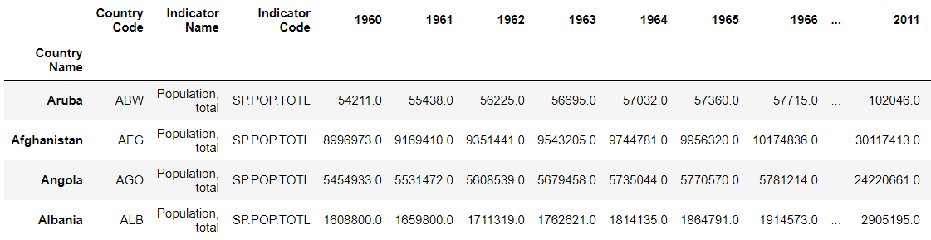
Data Understanding
Population dataset, that we found at The World Bank, contains the population of in 264 countries between 1960 and 2019. If we look at the Population dataset, we can see the appearance of the Population and the Internet Users dataset are similar. Because the sources from which datasets are provided are the same. This means we can easily make operations on them.

Slide 9
Data Understanding
Because some countries have few populations, the percentage of people using the internet may not yield reliable results about that country. For example, in 2000 the percentage of internet users of a country with a population of 100,000 was 80% does not indicate that the country is a very developed country. When we look at countries that could not have a population of more than 100,000 people by 2016, we often see that those countries are either newly established or underdeveloped. We will remove these countries because we think these countries are the outliers of our work.

Slide 10
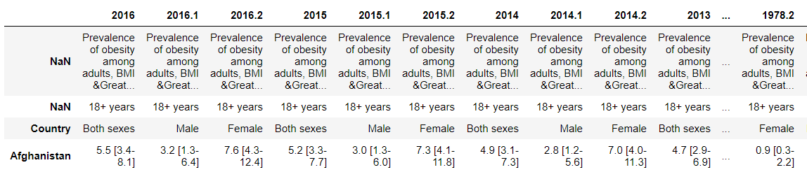
Data Understanding
Obesity dataset, that we found at Global Health Observatory Data Repository, shows the ratio of obese population of 195 countries of all years from 2016 to 1975 to real population by making gender discrimination in individuals over the age of 18.

Slide 11
Data Understanding
Since our other datasets are not separated by gender, we will only use the column that applies to both sexes out of 3 columns that are male, female and both sexes. However we don't have a The data type of this dataset is percentage of defined population with a body mass index (BMI) of 30 kg/m2 or higher. And this data is calculated with Worldwide trends in body-mass index, underweight, overweight, and obesity from 1975 to 2016: a pooled analysis of 2416 population-based measurement studies with 128.9 million participants.

Slide 12
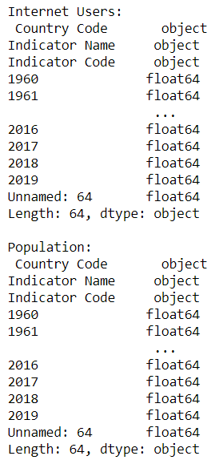
Data Understanding
If we look at the Internet_Users and Population
dataframes' column types we can see that
they are all floats except 3 columns at the beginning.

Slide 13
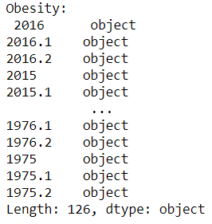
Data Understanding
If we look at the Obesity dataframe's
column types we can see that they are
all objects because they have inner columns
in them.
This information will be useful to us while editing
our data.

Slide 14
Data Preparation
Feature Selection
When examining the dataframe to be able to make feature selection, we can see 'Country Code', 'Indicator Name', 'Indicator Code' columns are not relative to our study. So these columns should be discarded.
As we did on Internet_Users dataframe, when examining the Population dataframe to be able to make feature selection, we can see 'Country Code', 'Indicator Name', 'Indicator Code' columns are not relative to our study. So these columns should be discarded.

Slide 15
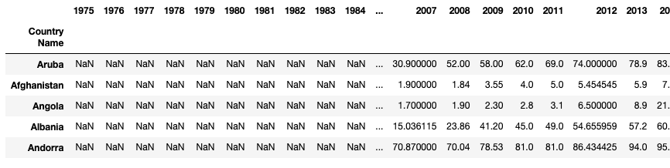
Data Preparation
Looking at the data we have, we can say the following:
Our Internet_Users and Population data set contains data from all years from 1960 to 2019. However, our Obesity data set contains data from 1975 to 2016. Therefore most of the data for 2019 and 2018 are missing, there is no harm in deleting these columns. Also, since we need to continue our work on the years common to all three data sets, we delete the years outside their intersection from the Internet_Users and Population datasets. Here is how it looks.

Slide 16
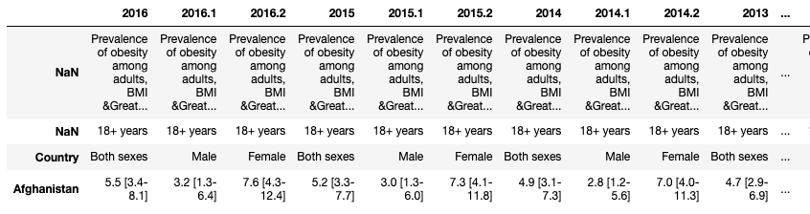
Data Preparation
There is no valuable data in the first 3 lines of the Obesity dataframe. So, the first step is the preparation of Obesity dataframe is getting rid of the first 3 rows.

Slide 17
Data Preparation
If we look at the columns, we see the numbers after the dot next to the years. These numbers are for sex discrimination. The years which has not any number next to them, represent both sexes. If the year has .1, then this means the columns has data of men. If the year has .2, then this means the columns has data of women. We got rid of the details given in square brackets to see the data more clearly.
Some values in the table are written as 'No d'. This string means 'No data', that is, the missing data. Although we think that these missing data should be filled in terms of the integrity of our project, when we open and look at the data, we see that all the missing data are in 'South Sudan', 'Sudan', 'San Marino', 'Monaco’. So we removed these countries from our dataset.

Slide 18
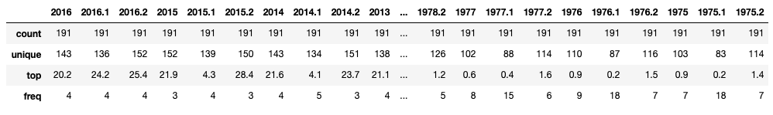
Data Preparation
After these operations and converting to our data types into numeric values, let's check the describe table.
According to the describe table we got last, there are many unique values in our data set, that is, there are few repetitive values. This expresses the detail of the data we use in our work. Because the fact that most of our data is the same means that the data is reached as a result of generalization or simplification.
As we mentioned before, we need to drop the columns ending with .1 and .2 since the gender gap has no relation with the data in our project.

Slide 19
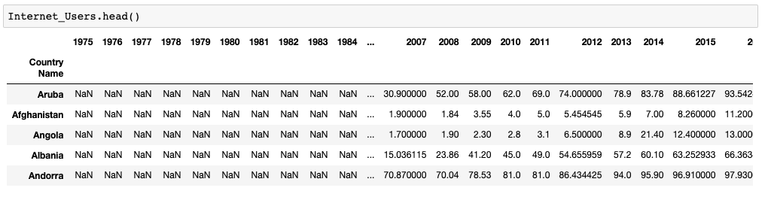
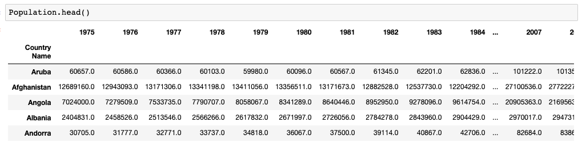
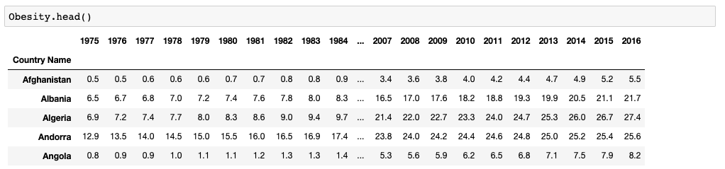
Data Preparation
After all these features determination operations, we made all the features of the 3 data frames the same.

Slide 20
Data Preparation
Finding The Common Countries
At the Obesity data set we have less country than Internet_Users and Population data set. Since a common study can be carried out on the countries they intersect, we must first find the countries they intersect, and then remove the countries outside these countries from all datasets.
After the column reduction process, it is seen that Internet_Users did not include all the countries included in the Obesity dataframe. Because the number of rows remained 162 only when there were crossing countries, and this number is less than the number of rows in the Obesity data set, which is 195.
In this case, we need to extract countries that do not intersect not only from Internet_Users and Population but also from the Obesity dataframe.

Slide 21
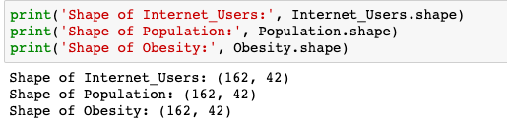
Data Preparation
As can be seen from the output below, we can now find 3 different data from the same countries in the dataframes for the same years.

Slide 22
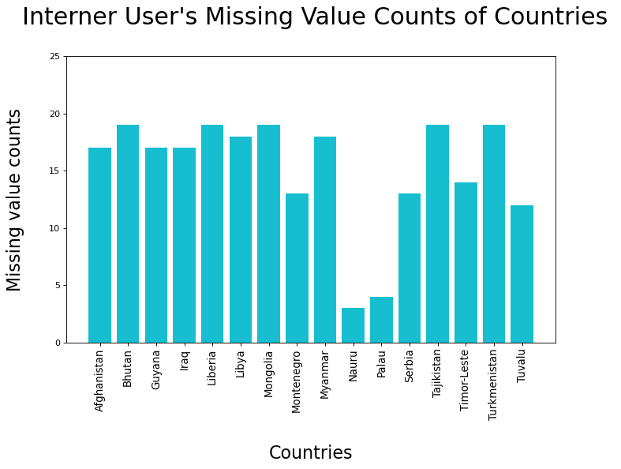
Data Preparation
Missing Values
Let's look at the Internet_Users's missing value counts of countries that have less than 20 entries.

Slide 23
Data Preparation
As can be seen from the Internet Users dataframe, the internet was not used in Montenegro before 2003. There is no need to remove this country from our dataframes, as the internet usage data is in all years since 2003.
When we look at the countries with less than 20 entries in order, we see that the data of only two countries are entered randomly by years, Nauru and Palau.
In this case we need to exclude these two countries from all our data sets.

Slide 24
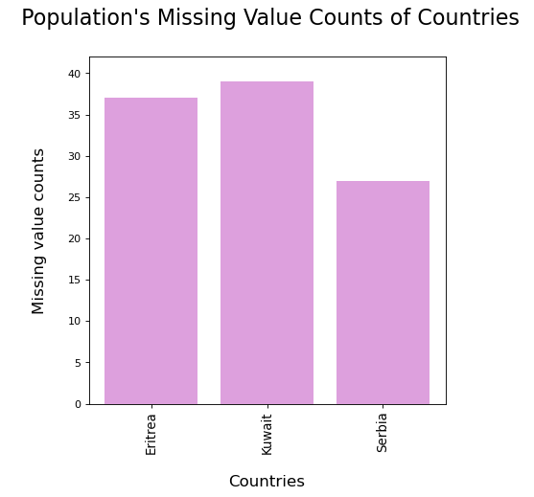
Data Preparation
Let's look at the Population's missing value counts and check if there is a year missing from 42 years.

Slide 25
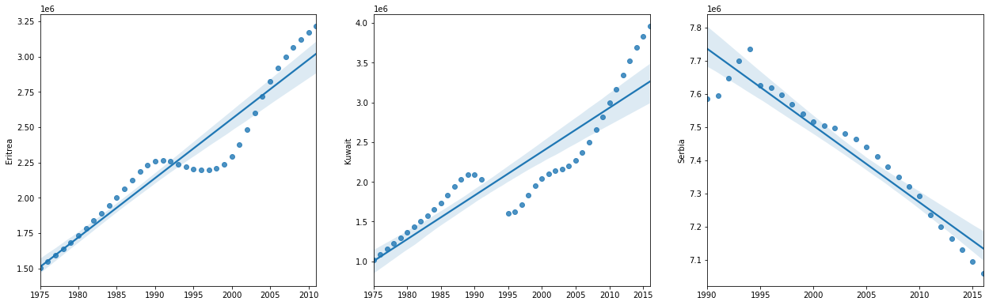
Data Preparation
To be able to make a decision about missing value handling on Population dataframe, we should gather more information from these 3 countries.
Based on the graph of the Eritrea series, we decided to interpolate on a segment basis with a piecewise polynomial interpolation to fill the missing values.

Slide 26
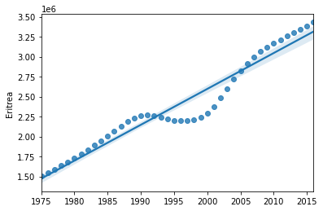
Data Preparation
Based on the graph of the Eritrea series, we should use polynomial interpolation to fill the missing values.

Slide 27
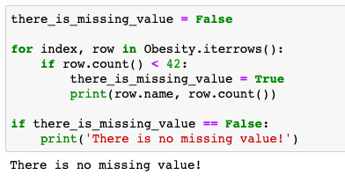
Data Preparation
Since serbia was founded in 2006, we fill in the population information before 2006 with 0.
Let's look at the Obesity's missing value counts and check if there is a year missing from 42 years.
Since we filled or dropped in the missing values that should be filled with interpolation methods or dropped in all dataframes, we can fill the remaining missing values with zero.

Slide 28
Data Preparation
Outlier Handling
When we look at countries whose population has not exceeded 100.000 15 times until 2016, we think that these countries are the outliers of our study since these countries are newly established, less developed or dispersed after a while.
Let's look at which countries are below the 100,000 population limit for how many years and draw a bar plot to better see which countries are below the limit.

Slide 29
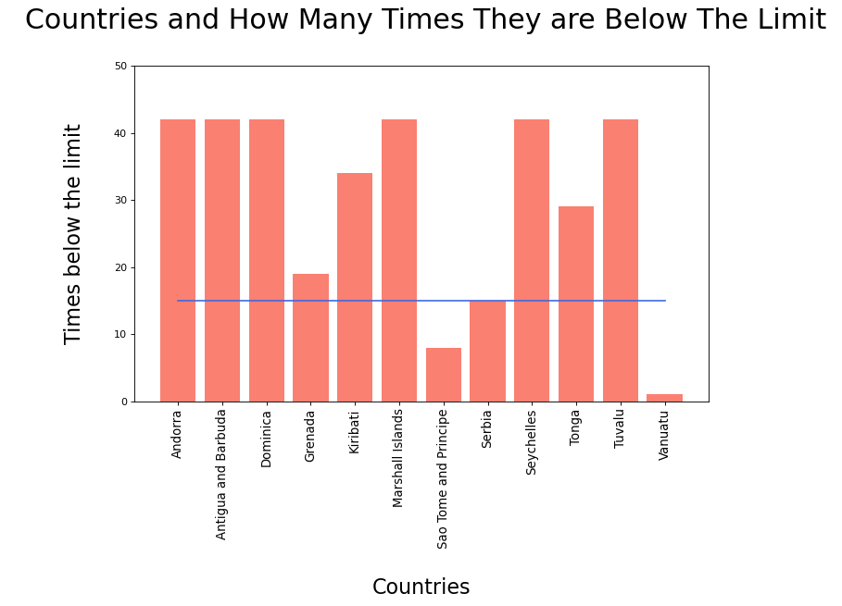
Data Preparation
As we can see from the chart, 3 countries which are Sao Tome and Principe, Serbia, Vanuatu below our limit. So, since these countries are outliers of our project, we should remove these countries from all 3 datasets.

Slide 30
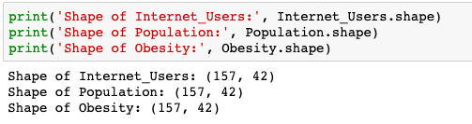
Data Preparation
Now we are in good shape.

Slide 31
Modeling
Simple linear regression model will be used for this study. Because our data is growing linearly.
Parameters are Internet Users and Obesity. We want to show Internet Users and Obesity are linearly dependent and test our model.

Slide 32
Evaluation
R-squared Error: 0.401
Mean Squared Error: 15.634
score() method calculates R-squared Error and mean_squared_error() calculates Mean Squared Error. As we have seen, error numbers of our prediction is high in our study on Turkey. We draw a regression plot to find out why.

Slide 33
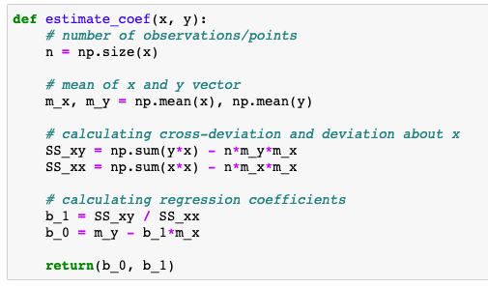
Evaluation
A function for coefficient estimation.

Slide 34
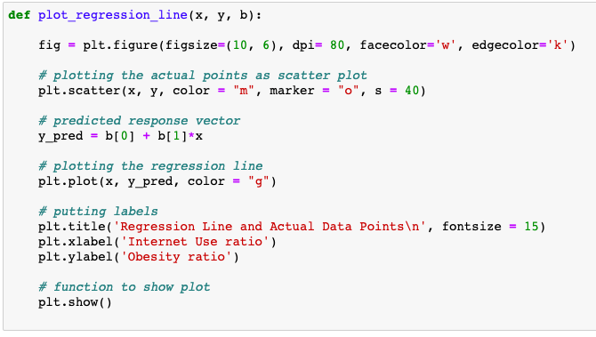
Evaluation
A function for custom regression line plotting for actual points of data.

Slide 35
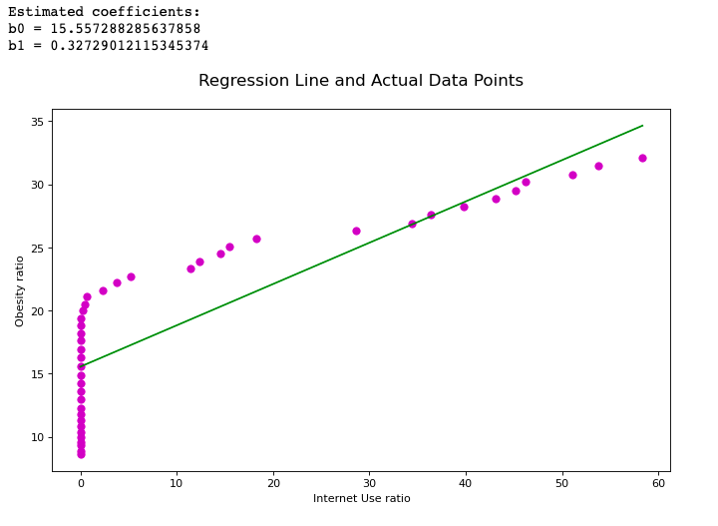
Evaluation
Drawing the regression plot for understanding why our error value is high.

Slide 36
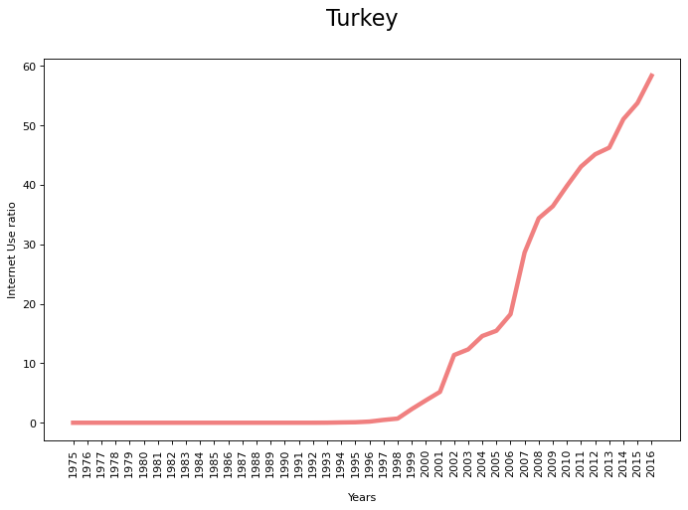
Evaluation
If we look at the graph we have drawn, the periods when the internet is not used greatly affect our estimates. So let's take these parts out and make a graph again.

Slide 37
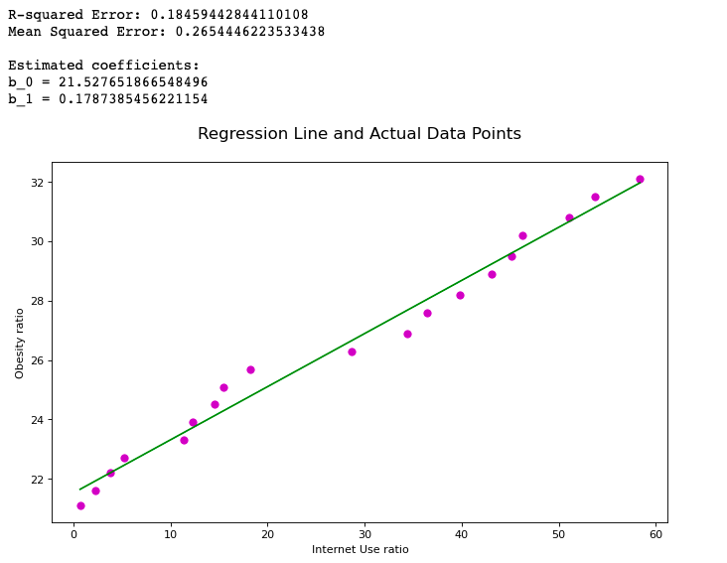
Evaluation
Then we create our linear regression model again with the data after 1997.

Slide 38
Evaluation
Our R-squared Error is 0.18 and Mean Squared Error is 0.26. So that means our model fits our data!
So this project is a result of the increase in the number of people who are obese with increasing use of the Internet in Turkey, so we can say that there is a linear relationship between them.

Slide 39
References
Linear Regression Implementation
https://www.geeksforgeeks.org/linear-regression-python-implementation/
Internet Users Dataset
https://data.worldbank.org/indicator/IT.NET.USER.ZS
Population Dataset
https://data.worldbank.org/indicator/sp.pop.totl
Obesity Dataset
https://apps.who.int/gho/data/node.main.A900A?lang=en

